Slide 1
Open source 360/VR player and subjective evaluation tool for Android platform
Louis-Maxence Garret
IC Faculty - IN-MA1 – Semester Project
Responsible assistant : Evgeniy Upenik
Supervisor: Prof. Dr. Touradj Ebrahimi
Notes:
Master student in CS

Slide 2
Objectives
Research and review state of the art in art visualization technologies for omnidirectional visual content.
Research and review state of the art in subjective and objective quality evaluation for omnidirectional visual content.
Develop a 360°player for Android OS using Google Cardboard SDK for equirectangular and cubic projections.
Omnidirectional still pictures
Omnidirectional video (optional task)
Implement user interface for subjective evaluation: paired comparison and single stimulus absolute category rating with hidden reference.
Optionally: extend the player to support other projections (truncated square pyramid projection, Icosahedral projection, etc.)
Document all the development process and final version of all codes.

Slide 3
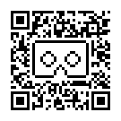
State of the art
Visualization technologies for omnidirectional content:
First developed for robotics and computer graphics
Head Mounted Displays (HMDs) now affordable
Embedded screen: HTC Vive, Occulus Rift…
Requiring smartphone: Gear VR, Google’s Cardboard…
Google Cardboard (Android)
3D content managed in OpenGL
Any constructor can manufacture a Cardboard HMD
Calibration done with QR Code

Slide 4
State of the art
Subjective and objective quality evaluation for omnidirectional visual content :
For 2D flat content, there exists lots of objective metrics
Peak signal-to-noise ratio (PSNR), Structural similarity (SSIM)…
For omnidirectional visual content, no agreement on an objective metric
Some suggested, e.g. Sphere based PSNR computation (S-PSNR)
Few subjective benchmarks done, mostly predictions
Testbed provides ground-truth subjective scores to assess performance of objective quality metrics

Slide 5
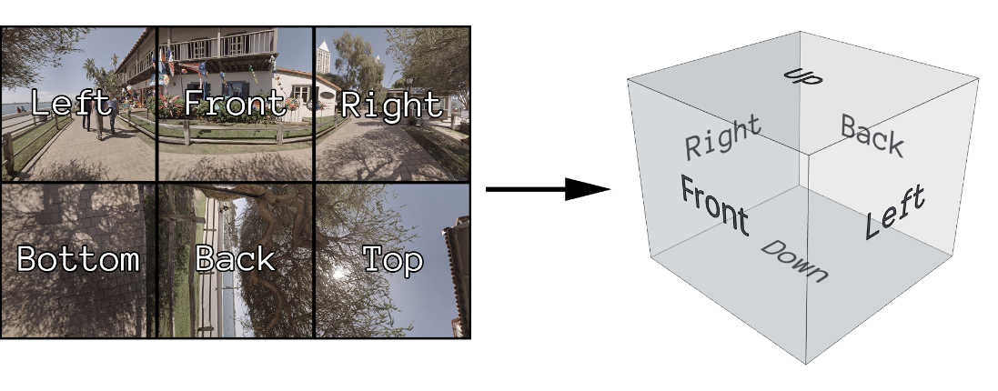
Testbed360
Let participants rate omnidirectional still pictures
5 grades : Excellent, Good, Fair, Poor, Bad
They are first trained with Excellent, Bad and Fair pictures
Then are asked to assess quality of n pictures
Supports Cubic and Equirectangular projections

Slide 6
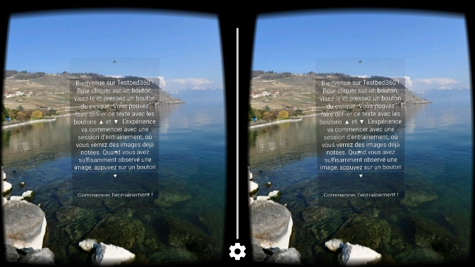
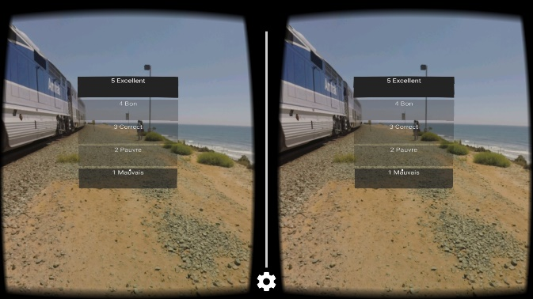
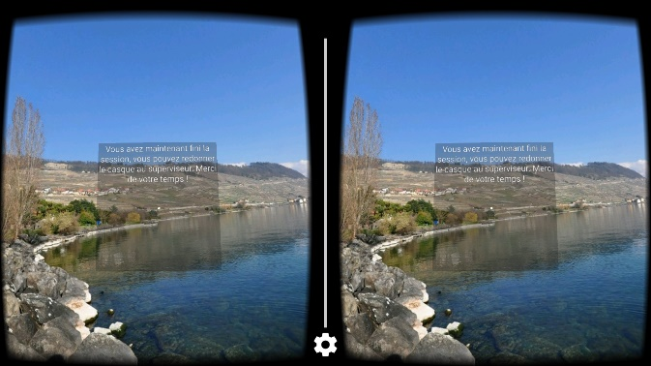
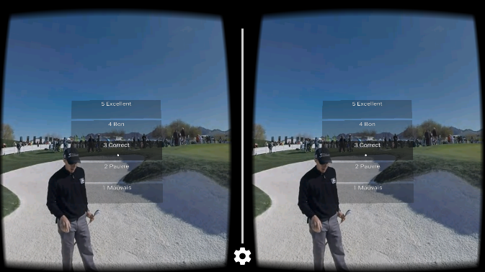
Storyboard of Testbed360
x3
Welcome Scene
Training
x18
End Scene
Evaluation

Slide 7
Development
For Android 5.1 (API 21) minimum
Used Cardboard SDK and OpenGL library Rajawali
Projections done by decoding pictures into Bitmaps
Bitmaps used to create textures, binded to 3D primitives
Sphere for equirectangular, cube for cubic
User interface designed with Android Studio’s layout editor and drawn into Bitmaps, then binded to primitives’ textures
Background task records grades (& movements every 33ms)

Slide 8
Demo
Demo
Notes:
HELP TEXT
CARDBOARD QR CODE

Slide 9
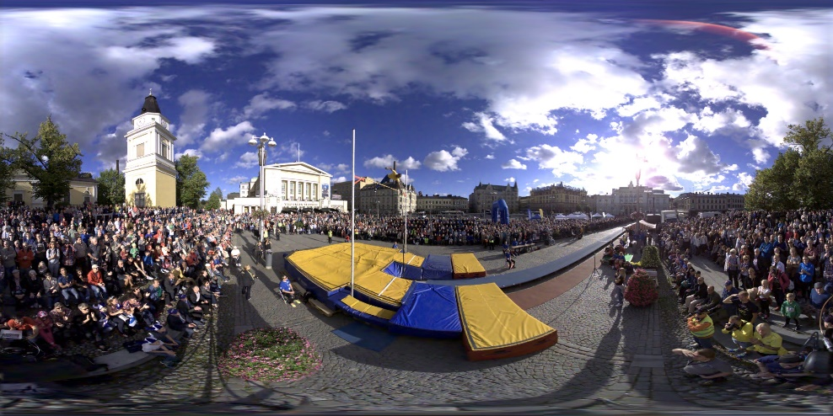
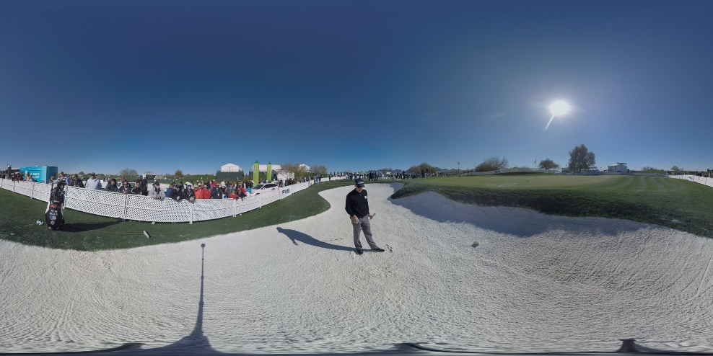
Subjective experiment
Two original raw pictures chosen (reference stimuli)
Two codecs chosen: JPEG and JPEG2000
Images compressed with both codecs in all qualities
4 different bits per pixel ratio (BPP) chosen: 0.07,0.45,0.85, 4.3
2 pictures x 2 codecs x 4 BPPs + 2 raw = 18 pictures to grade

Slide 10
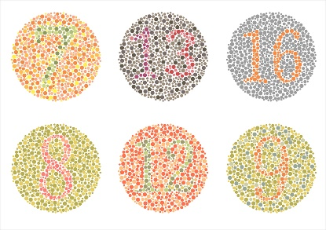
Methodology
Conducted on 19 naive subjects
14 men and 5 women, ages between 19 and 25, with average and median of 21.84 and 22.0 respectively.
Correct color vision tested with Ishihara chart
Linguistic preference between French and English was asked
Oral explanations given first
Order of pictures randomized by Testbed
All participants able to finish

Slide 11
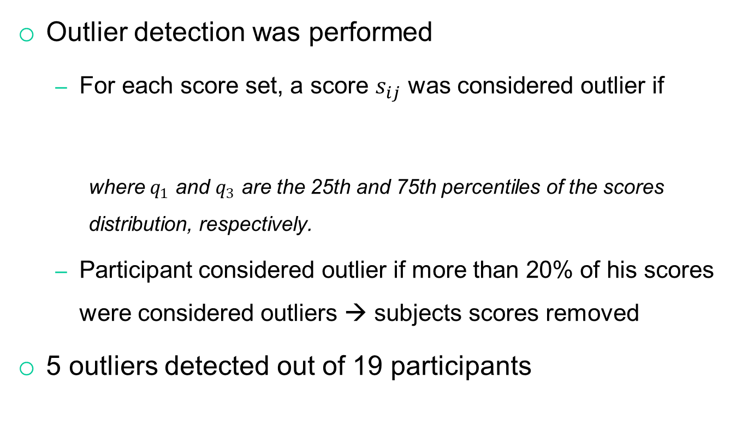
Data analysis
Outlier detection was performed
For each score set, a score $s_{ij}$ was considered outlier if
where $q_{1}$ and $q_{3}$ are the 25th and 75th percentiles of the scores distribution, respectively.
Participant considered outlier if more than 20% of his scores were considered outliers → subjects scores removed
5 outliers detected out of 19 participants
$$s_{ij}> q_{3}+1.5 \left(q_{3}−q_{1}\right)∨s_{ij}< q_{3}−1.5 \left(q_{3}−q_{1}\right)$$

Slide 12
Results and discussion
Results for low BPPs as expected
High BPPs: underrated performances on «PoleVault»
Transparent quality for high BPPs on «Golf»
Notes:
MOS plotted against BPP
Red for JPEG, Green for JPEG2000
Red filled area is CI for Reference Stimuli

Slide 13
Possible improvements
Omnidirectional video support (h264, h265)
Add projection types
Push data collected on a server
Produce continuous fixation maps

Slide 14
Conclusion
State of the art covered
Testbed for Android developed, 4400 LOCs written
Subjective quality evaluation conducted: 19 participants
Data analysis performed

Slide 15

Questions?
Thank you!
Louis-Maxence Garret
Multimedia Signal
Processing Group
EPFL
louis-maxence.garret@epfl.ch
http://mmspg.epfl.ch/

